Slide 1
Selecting A School in Singapore: Beyond Grade-based Entry Requirements and Popular "Top" Schools
By DC Lim

Slide 2
Introduction
Singapore is a small nation-state in South-east Asia, with a population of about 5 million people. Its education system ranks among the best in the world, where its students consistently come in among the top few worldwide in PISA scores. A good education is highly prized for it brings promise of a stable, high-paying job in the future. Hence, a place in the popular "top" schools is highly sought after, right down to primary (elementary) school. Good foundations pave the way for good test scores for entry into the best schools in the next level of the education system, so goes the general thinking.
Practically every Singaporean parent with school-going children knows the game. The popular "top" schools are household names too. Some schools are also known for being the best at certain sports or competitive games. Based on performance in preliminary exams sat for in the final year of elementary and high school, each student roughly knows what "tier" of schools he/she can enter in the next level of the system. Grades are make or break, literally.

Slide 3
Introduction
However, basing a major decision on just 1 factor is a little shoddy and boring, isn't it? What about life outside school? Where can a student hang out with friends or go on a date after school? What are the lunch options available? For the tiger moms/dads out there - are there entertainment options aplenty nearby that might distract their children from going straight home for yet more study and revision?
For this project, I will put aside test scores and "top schools", and explore the neighbourhoods of schools in Singapore to identify various groups of schools that might cater to different profiles of students and their parents.

Slide 4
Data
Data on Singapore schools can be obtained from data.gov.sg, a publicly-accessible database maintained by the Singapore government that contains datasets on different aspects of the country.
The dataset relevant to this project can be downloaded as a csv file from the School Directory and Information page on the website. The dataset contains the names of schools in Singapore and basic information for each such as address (including postal code), phone number, level (e.g. primary/secondary school) and so on.
Postal codes are essential for the purposes of this project, since they will be geocoded to obtain the latitude and longitude of each school. This will allow us to tap on Foursquare's database to obtain the nearby venues for analysis and subsequent clustering using the K-means clustering machine learning technique.

Slide 5
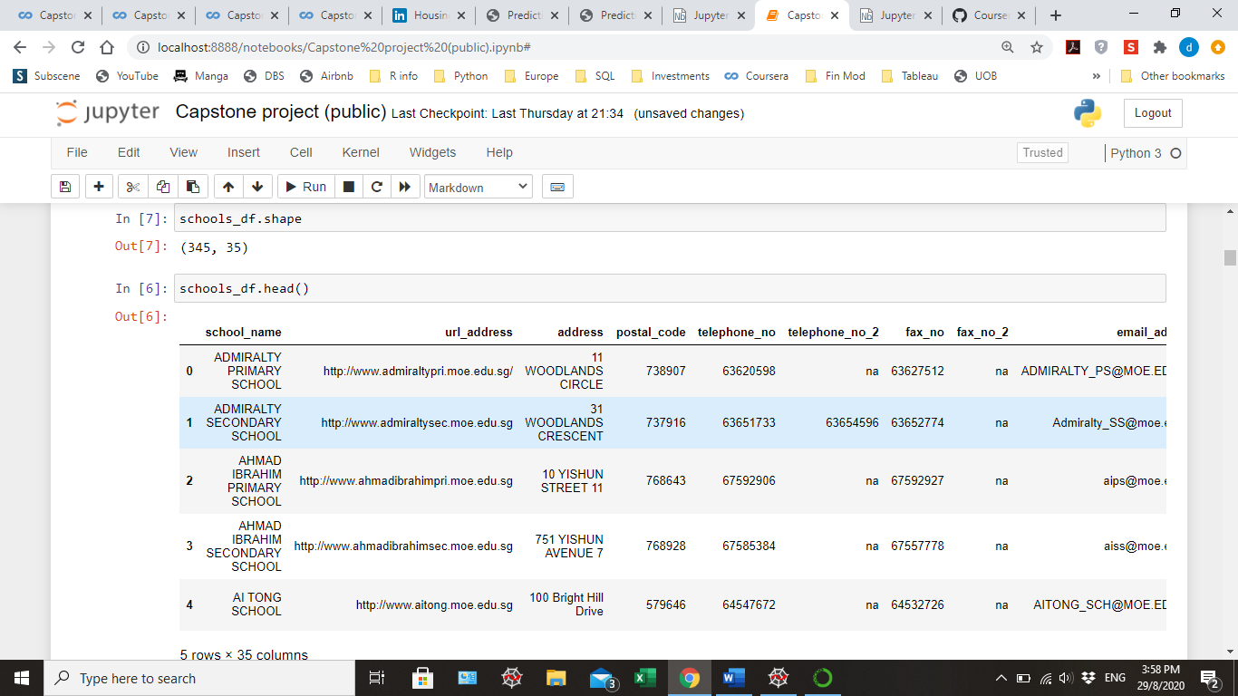
Extract of dataset

Slide 6
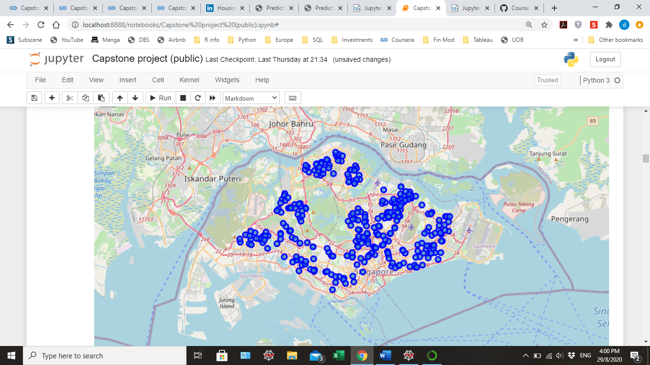
Map showing school locations in Singapore

Slide 7
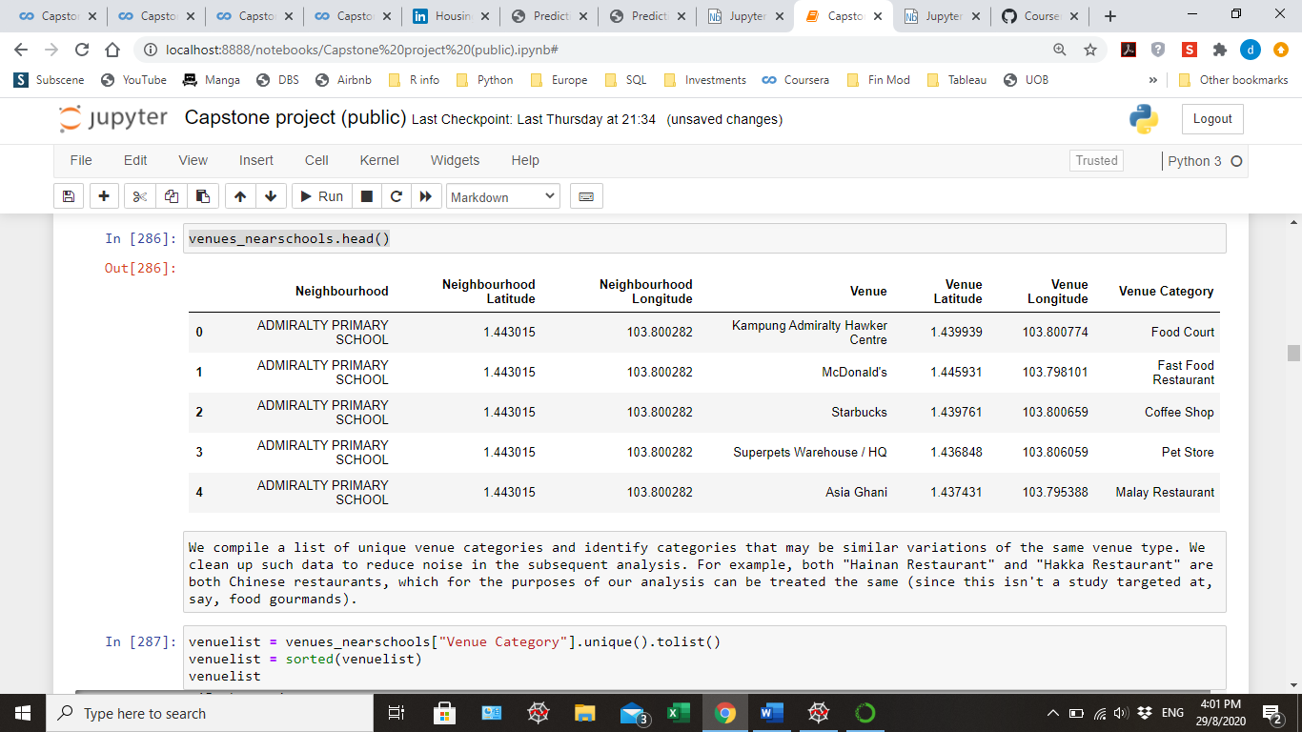
We explore the neighbourhoods within 1 km radius around the schools by using Foursquare to obtain data of nearby venues, as shown:

Slide 8
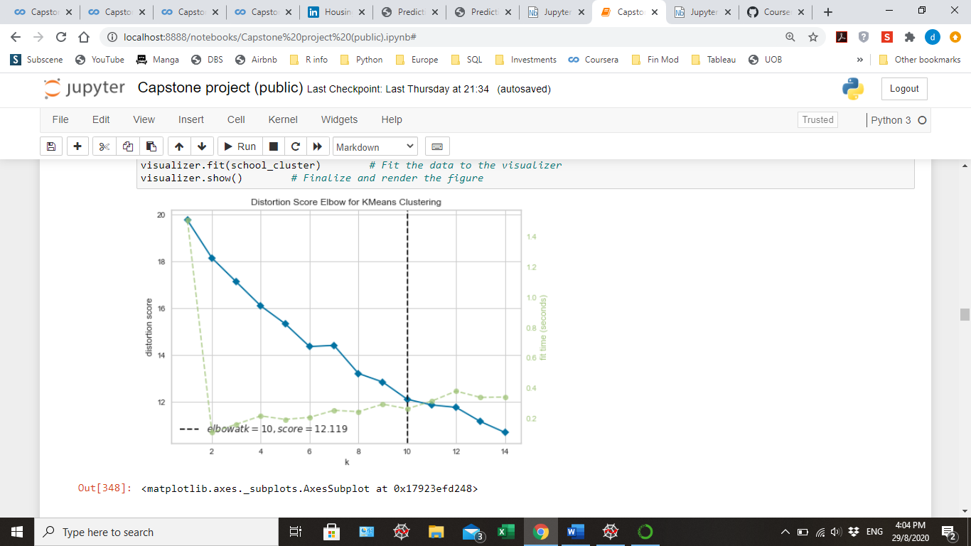
We prepare the dataset for K-means analysis to group the various school neighbourhoods into clusters by using one-hot encoding. Next, we initialise K-means modelling and find the optimal K value using the elbow method – optimal K is 10.

Slide 9
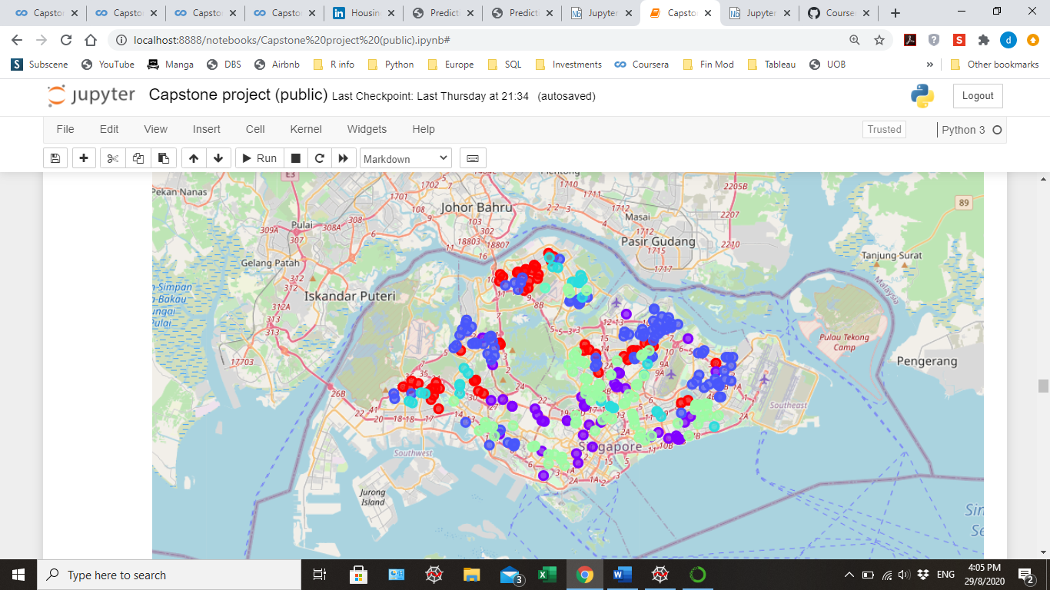
We create a map to visualise the resulting clusters:

Slide 10
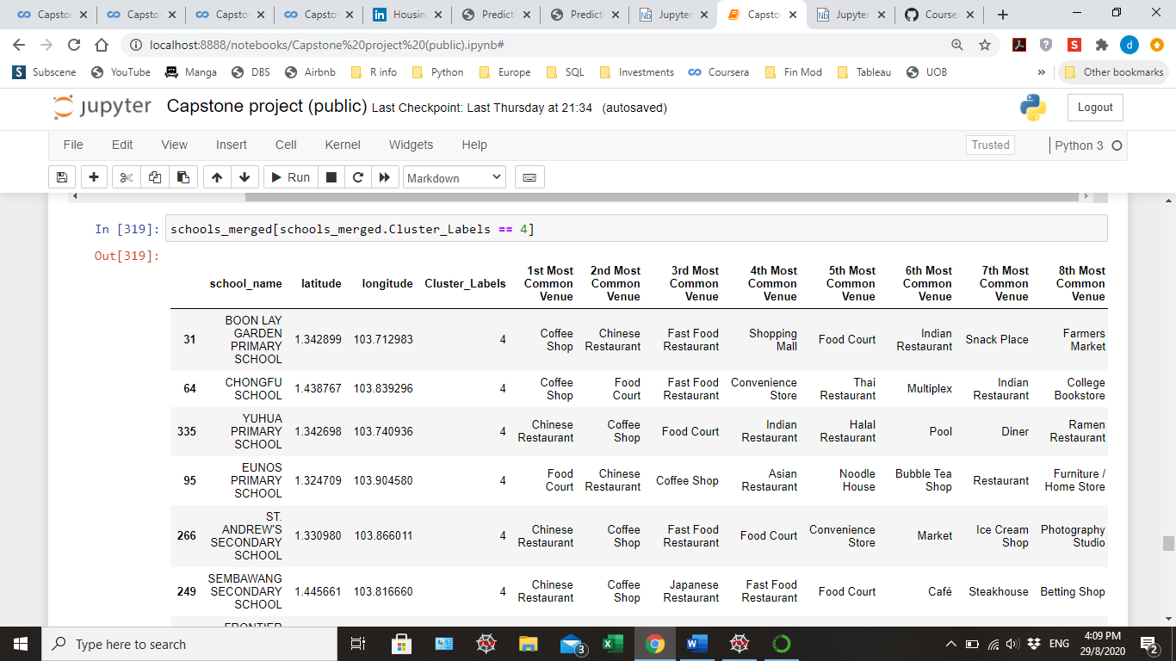
Identify significant clusters for further analysis
By doing a count of the number of members in each cluster, we see that the most significant clusters are clusters 2, 6, 0, 1 and 4 in descending order of size. Clusters 8, 7, 5 and 3 are much smaller in size. For the purposes of our analysis, let us focus on the first group of clusters since it will offer more choices for our potential users within each cluster.
By subsetting the dataset according to the each of the significant clusters, we examine each cluster in turn to understand the profile of the neighbourhood around the schools. For example:

Slide 11
Discussion
Cluster 2 - Majority of the school neighbourhoods have Coffee Shop as the first most common venue. Fast Food Restaurant occurs frequently in the top or second top venue. Japanese Restaurant, Shopping Mall, Sandwich Place and Supermarket appear more frequently in this cluster compared to other clusters. Schools in this cluster are predominantly located in the northern half of Singapore.
Cluster 6 - This cluster is predominantly comprised of F&B businesses in the top 10 venues. Majority of the school neighbourhoods have Chinese Restaurant as the first most common venue. Food court appears frequently in the top or second top venue. Cafe, Fried Chicken Joint, Frozen Yogurt Shop and Vegan/vegetarian Restaurant appear more frequently in this cluster compared to other clusters. Schools in this cluster are predominantly located in the southern half of Singapore.

Slide 12
Discussion
Cluster 0 - Majority of the school neighbourhoods have Food Court as the first most common venue. Park, Bar and Bus Station appear more frequently in this cluster compared to other clusters. Sports/exercise venues such as Pool, Gym, Trail and Soccer Stadium appear with the highest frequency in this cluster compared to other clusters. Schools in this cluster are predominantly located in north and west of Singapore.
Cluster 1 - Wide mix of venue categories come under first most common venue in this cluster - no obvious trend. Hotel, Fish & Chips Shop and Filipino Restaurant appear more frequently in this cluster compared to other clusters. Overall, there is a wide mix of F&B and recreational/entertainment venues; the widest amongst the 5 clusters. Schools in this cluster are predominantly located in south and east of Singapore.
Cluster 4 - Like Cluster 6, this cluster is predominantly comprised of F&B businesses in the top 10 venues, though to a lesser extent since it has more recreational venues like Bowling Alley, Multiplex and Bookstore. Majority of the school neighbourhoods have either Chinese Restaurant or Coffee shop as the first most common venue. Fast Food Restaurant, Food Court and Chinese Restaurant also occur frequently in the top 4 venues. This is the smallest cluster, and the schools are scattered throughout Singapore, except for the south.

Slide 13
What type of "users" would prefer each cluster profile?
Parents may prefer to send their children to a school in either Cluster 6 or 4 if they want their children to have a quick meal after school before heading home. There are not many recreational options that may pose distractions. These may be for families where both parents have full-time day jobs, and are unable to pick up their kids immediately after school.
Parents may prefer to send their children to a school in Cluster 0 if they are keen to have their children adopt a healthy lifestyle that can make use of the amenities that tend to be close by, such as Pool, Soccer Stadium etc.
Students may choose to enroll in a school in either Cluster 2, 6 or 1 if they want access to a wider variety of recreational and entertainment options after school where they can hang out with friends.

Slide 14
Conclusion
In conclusion, we can see that the neighbourhoods around schools in Singapore can be clusterd into 5 big and distinct groups, each with their own profile based on the most common venue types found in them.
The study can provide further information for both students and parents alike in selecting schools based on the type of neighbourhoods they are in, in addition to the usual grade-based entry requirements, popular brand names, sporting excellence and so on.

